Slide 1

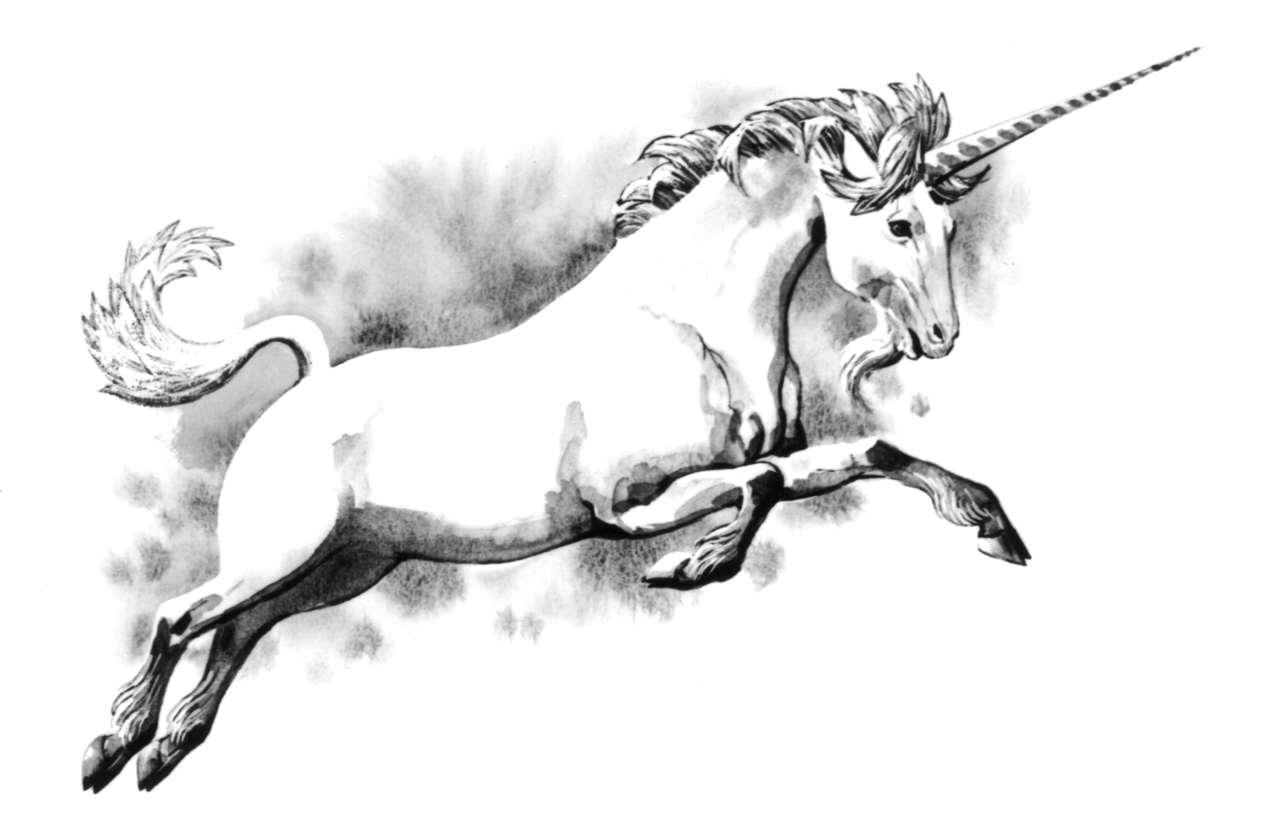
Binary Bastards

Slide 2



















Slide 3


Slide 4
Great Job! Level Complete

Slide 5
Game Over!

